Slide 1
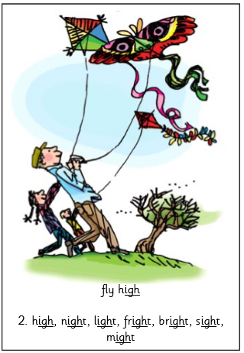
igh
fly high
Practice writing the ‘igh’ grapheme in the air with your finger:
Can you do one big?
One small?
One GIANT?

Slide 2
igh
fly high
Think of some words that have ‘ay’ in:
flight
night
high
sight
light
bright

Slide 3
igh
fly high
Practise writing a line of ‘igh’ on a piece of paper or in a note book.
Don’t forget your finger spaces!
Challenge: Write the words ‘high’, ‘light’ and ‘night’.

